Slide 1
Supply Chain Analytics Case Study for ABC Ltd Absolute Analytics Solutions
Consultants
Anshuman
Vijaykumar
Shravani
Sachin

Slide 2
Introduction:
ABC Ltd. is the worlds largest manufacturer of bathing soaps. Its HQ located in Milwaukee, WI, USA and have 10 Manufacturing units WW.
ABC produces 3 different varieties of bathing soaps
Tigers for Kids
Alexa for women
Wild Rancher for Men
Problem Statement
At the end of Dec 2016, the CEO realized that the growth rates have been less than satisfying but the more deeper concerns were with the margins.
Goal
Improve Margins/Profitability by reducing input costs
To improve reach and be competitive in market without change in pricing
To ease the existing process working with Vendors

Slide 3
Current Analysis
Historical revenue Numbers in Bn $
Year\Units | USA (NA & SA) | Europe | China | ISA | APAC | TOTAL
2013 | 1.2 | 0.4 | 0.1 | 0.05 | 0.05 | 1.8
2014 | 1.25 | 0.5 | 0.15 | 0.05 | 0.05 | 2
2015 | 1.5 | 0.7 | 0.2 | 0.05 | 0.05 | 2.5
2016 | 1.8 | 0.9 | 0.2 | 0.05 | 0.05 | 3
Growth %
Year\Units | USA (NA & SA) | Europe | China | ISA | APAC | TOTAL
2014 | 4.17% | 25.00% | 50.00% | 0.00% | 0.00% | 11.11%
2015 | 20.00% | 40.00% | 33.33% | 0.00% | 0.00% | 25.00%
2016 | 20.00% | 28.57% | 0.00% | 0.00% | 0.00% | 20.00%
Revenue of soap Brands per region for 2016 in BN $
Year\Units | USA (NA & SA) | Europe | China | ISA | APAC | TOTAL
Tiger | 0.2 | 0.15 | 0.11 | 0.02 | 0.02 | 0.5
Alexa | 0.6 | 0.55 | 0.05 | 0.02 | 0.02 | 1.24
Wild Rancher | 1 | 0.2 | 0.04 | 0.01 | 0.01 | 1.26
Total | 1.8 | 0.9 | 0.2 | 0.05 | 0.05 | 3

Slide 4
VED Analysis
Vital - Oil
Essential - Abrasive, Potassium Hydroxide
Desirable - Fragrances & Perfumes
As per our observation, we consider Vital ingredient i.e. oil and find possible ways to save the cost.

Slide 5
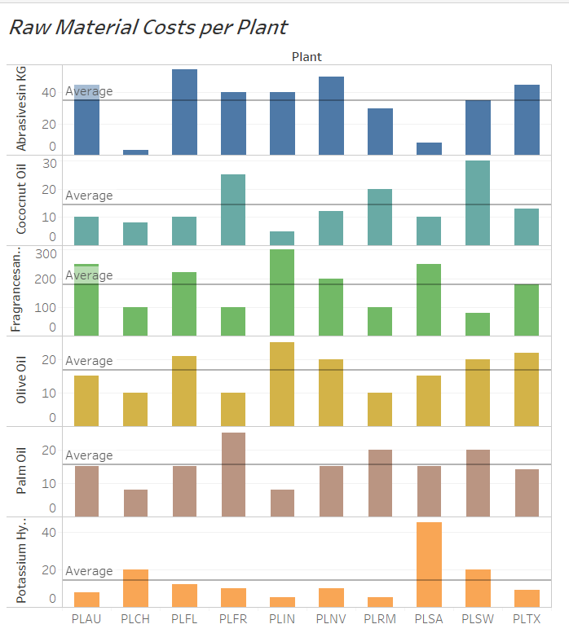
1. Reduce Procurement Costs
From the Bar Chart we can notice that some plants are paying more than average for the same raw material.
Raw Material | Plants paying more than Average
Abrasive | PLFL, PLNV, PLTX
Coconut Oil | PLFR, PLRM, PLSW
Fragrances & Perfumes | PLAU, PLFL, PLIN, PLNV, PLSA
Olive Oil | PLFL, PLIN, PLNV, PLSW, PLTX
Palm Oil | PLFR, PLRM, PLSW
Potassium Hydroxide | PLCH, PLSA

Slide 6
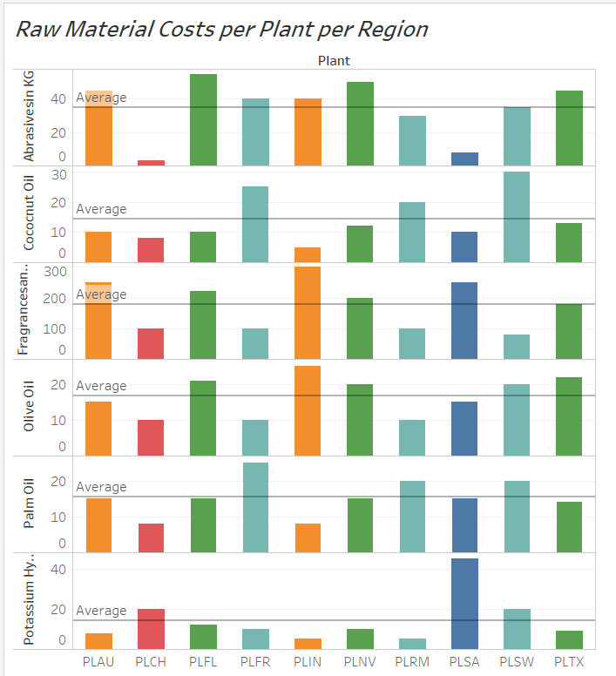
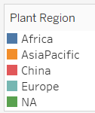
1.1 Procurement Costs Region wise
The selling price of the three varieties of Soaps is constant:
Tiger - 8 USD
Alexa - 12 USD
Wild Rancher - 10 USD
Plants like PLAU, PLFL, PLSW have higher raw materials costs.
Considering the Selling Price being constant, the Profit margins would be lower in these Regions.

Slide 7
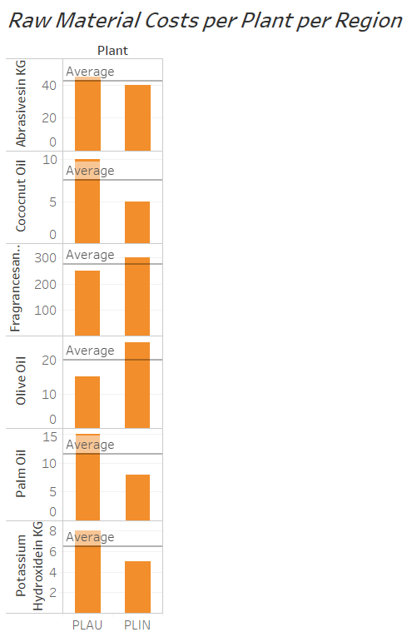
1.2 Reduce Procurement Costs – ASIA PACIFIC
REGION – ASIA PACIFIC
Raw Material | Plant paying more
Coconut Oil | PLAU
Fragrance&Perfumes | PLIN
Olive Oil | PLIN
Pal Oil | PLAU
Potassium Hydroxide | PLAU
Let’s look at the Raw Material Procurement Cost Region wise.
In Region Asia Pacific, plant PLAU has procuring costs for 3/6 items. Plant PLIN has procuring costs for 2/6 items.
Considering the Geography of Indonesia and Australia, the Raw Materials can be transported via Ship to and from.
Indonesia → (Ship) Potassium Hydroxide, Palm Oil, Coconut Oil → Australia
Australia → (Ship) Olive Oil, Fragrances & Perfumes → Indonesia

Slide 8
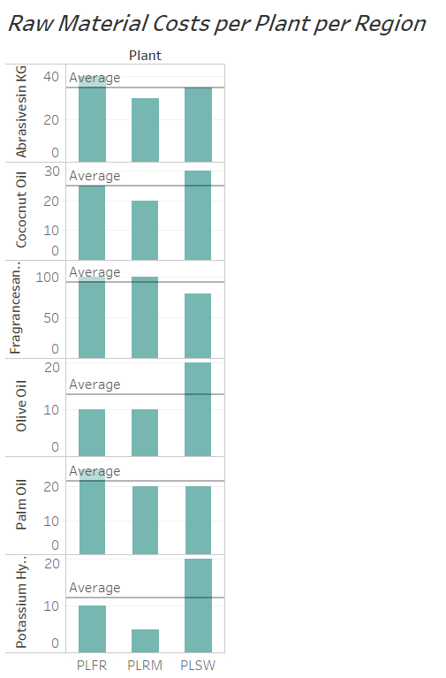
1.3 Reduce Procurement Costs - EUROPE
REGION - EUROPE
Raw Material | Plant paying more
Olive Oil | PLSW
Palm Oil | PLFR
Potassium Hydroxide | PLSW
Coconut Oil | PLSW
Let’s look at the Raw Material Procurement Cost Region wise.
In Region Europe, plant PLSW has higher procuring costs for 3/6 items when compared to PLRM

Slide 9
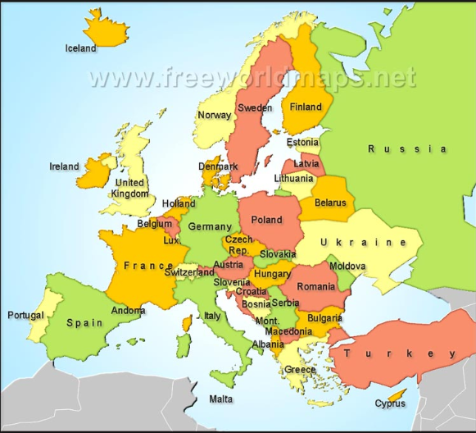
Contd…
We can consider supplier from Romania for the below Raw materials to be sent to plant PLSW:
Potassium Hydroxide
Olive Oil
Coconut Oil
Abrasive in KG
We can consider supplier from Romania for the below Raw materials to be sent to plant PLFR:
Palm Oil
Frangrance & Perfumes
Coconut Oil
Abrasive in KG
Looking at the Geography of Romania, France and Sweden. Options for transporting the raw materials (Road/Ship)
1. Romania ->(Road) Ukraine ->(Road) Poland -> (Ship) Sweden
2. Romania -> (Road) Hungary -> (Road) Austria -> (Road) Switzerland -> (Road) France
Option 1 is definitely worth considering for reducing the Procurement Costs for PLSW.
Also, the same containers can transport Frangrances & Perfumes back to PLRM.
This will however add additional Transport Costs.

Slide 10
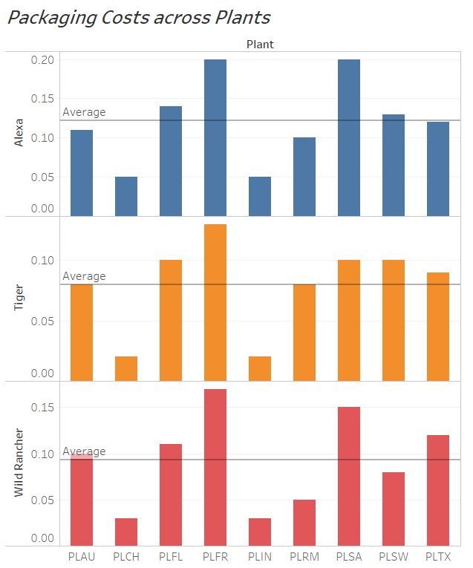
2. Packaging Costs
Looking at the Packaging Costs across Plants:
Packaging Costs are much higher in PLFR, PLSA followed by PLAU.
Packaging Costs are much cheaper in PLCH and PLIN.
We can consider shipping of Packaging material from China & Indonesia to other Regions – NA, Europe, Australia, South Africa.
This might involve identifying new suppliers from China and Indonesia who can provide Packaging material at the same or lesser cost.
Indonesia →(Ship) Australia
China →(Ship) South Africa, Europe, NA

Slide 11
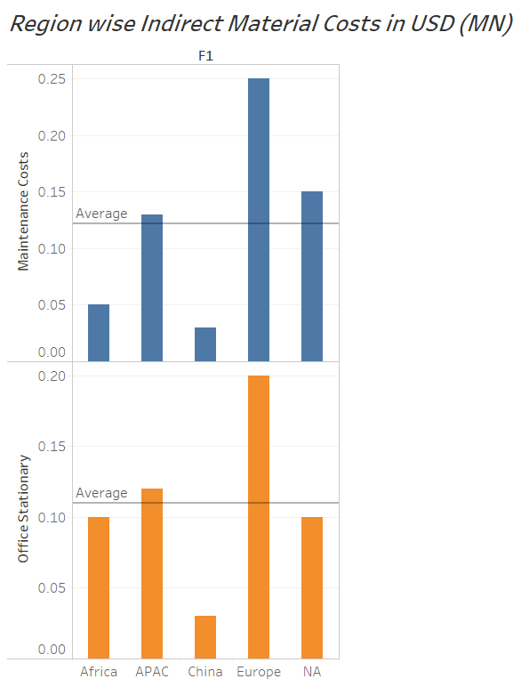
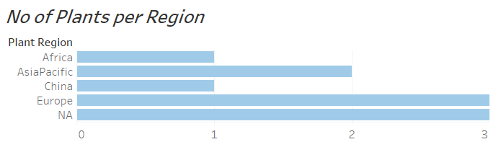
3. Indirect Material Procurement Costs
Maintenance Costs:
Europe and NA with 3 plants each has very high Maintenance Costs. Europe has 0.1 Mn $ costs higher than NA.
APAC with only 2 plants has higher costs than NA.
Stationary:
Europe and APAC regions have highest Stationery Costs.
Europe has 0.1 Mn $ costs higher than NA.
2. APAC with only 2 plants has higher Stationery costs than NA.
3. Africa with only one plant has very high Stationery Costs

Slide 12
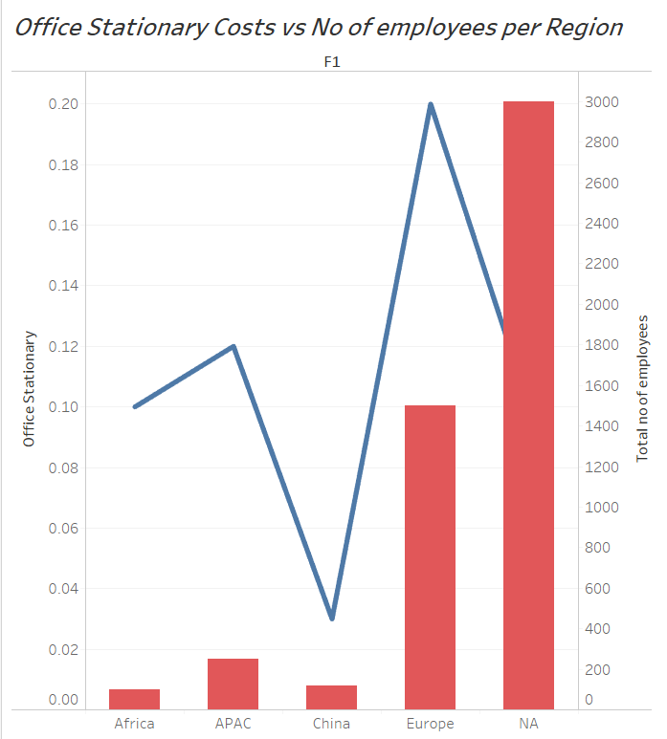

3. Indirect Material Procurement Costs
Comparing the findings from previous slide with the number of employees.
Africa & APAC both have very high Stationery Costs.
Europe has lesser employees than NA, but has higher Stationery Costs than NA.
China’s costs are also high compared to NA
NA Region is managing the Stationery Costs well.
There is definitely scope to regulate the costs of Stationery in Africa, APAC, Europe and China Regions.

Slide 13
Recommendations:
Since Indonesia is the largest producer of Coconut and Palm Oil, we can recommend to manufacture Wild Rancher and Tiger soaps in same country and ship to others (Nearer Regions), same for Alexa which can be produced in Europe.
Also Considering the lower packaging cost in Indonesia and china.
We can also export olive oil from Spain(Europe) to other manufacturing plants across the world and get Palm oil and Coconut oil back.

